Slide 1
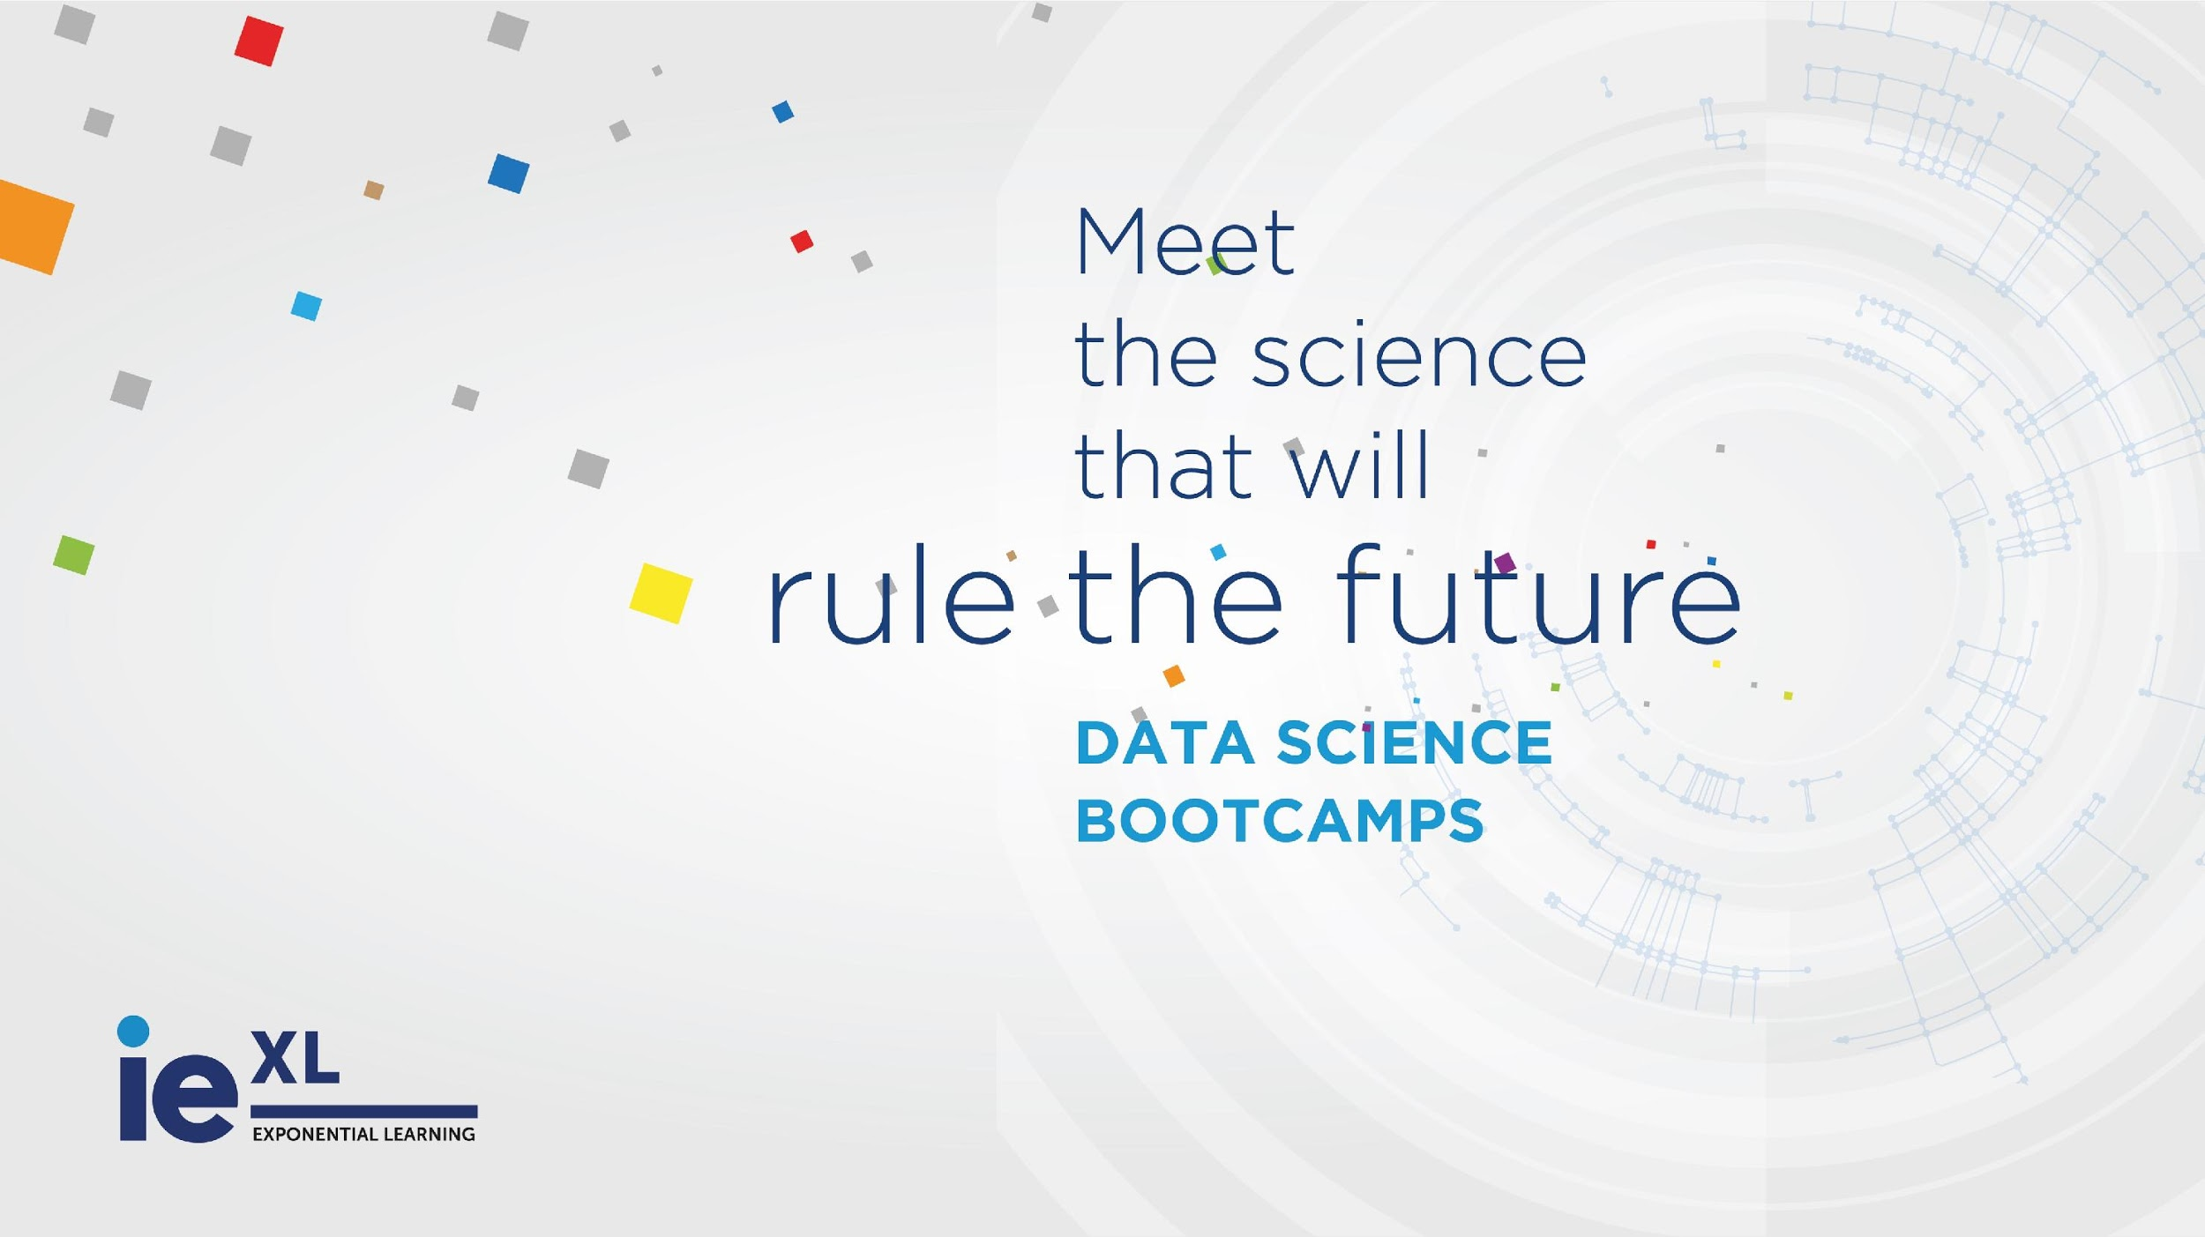


Slide 2
recommendation system
Notes:
‹#›

Slide 3
Notes:
‹#›

Slide 4
recsys
theory
a recommender system predicts the likelihood that a user would prefer an item based on previous user interaction
the goal is to recommend a item to and user
Notes:
‹#›

Slide 5
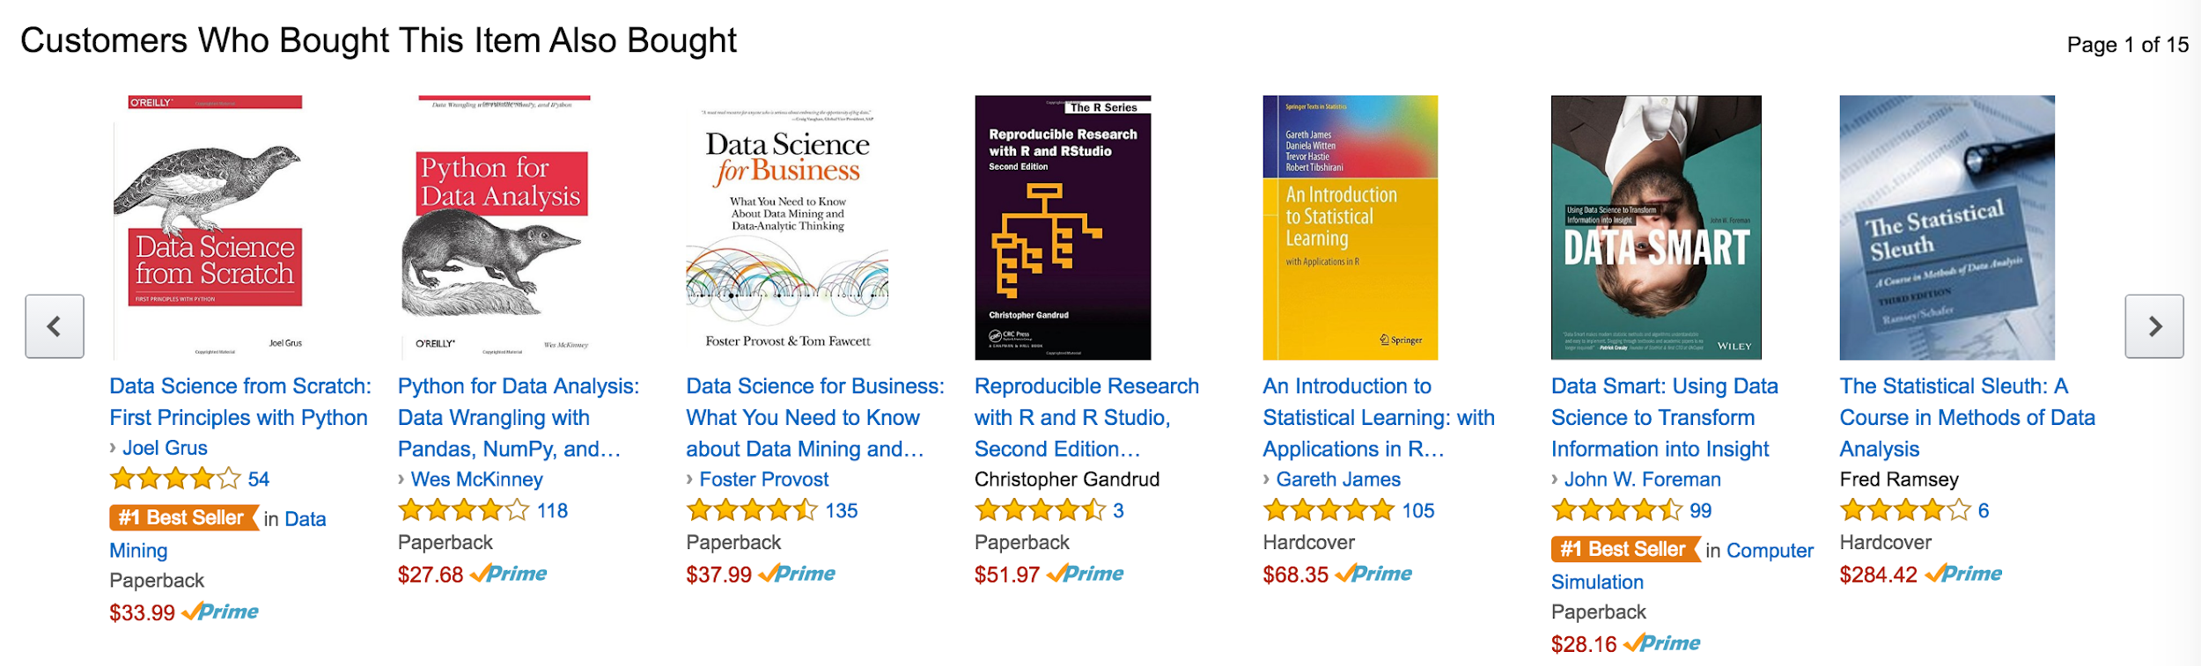
recsys
theory
what kind of recommendation system?
Notes:
‹#›

Slide 6
recsys
theory
collaborative filtering
Notes:
‹#›

Slide 7
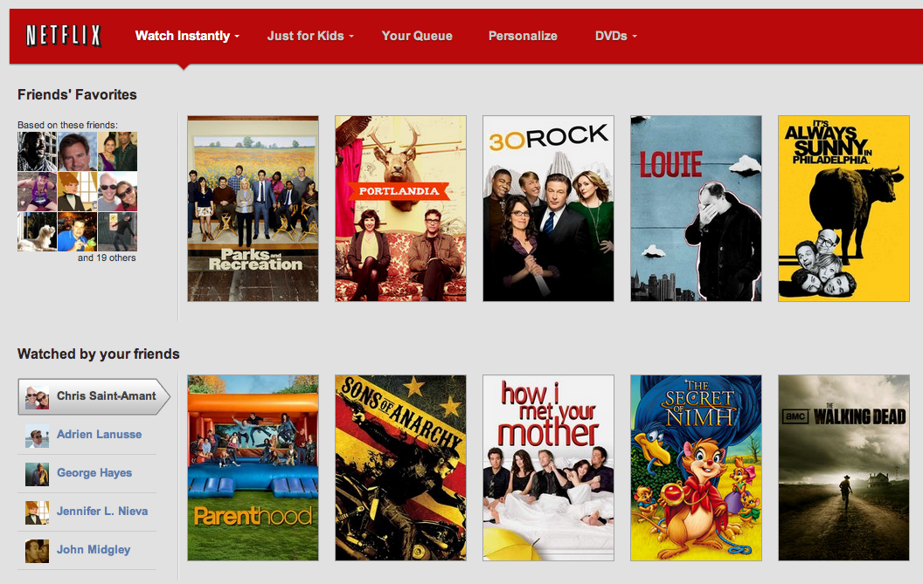
recsys
theory
Notes:
‹#›

Slide 8
recsys
theory
collaborative filtering
Notes:
‹#›

Slide 9
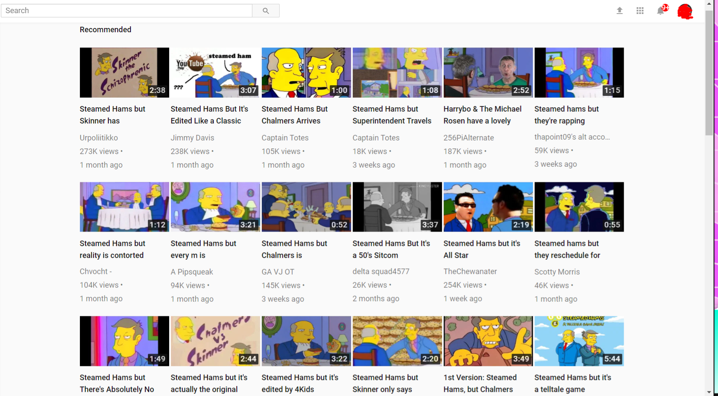
recsys
theory
Notes:
‹#›

Slide 10
recsys
theory
content based
Notes:
‹#›

Slide 11
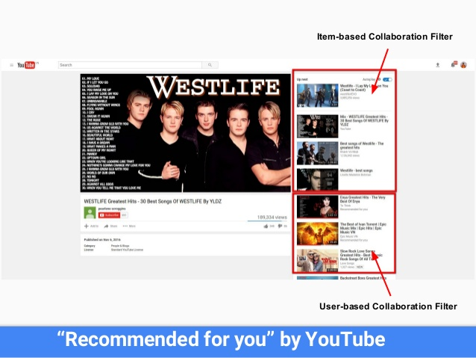
recsys
theory
Notes:
‹#›

Slide 12
recsys
theory
both (item and user collaborative filtering)
not an hybrid
Notes:
‹#›

Slide 13
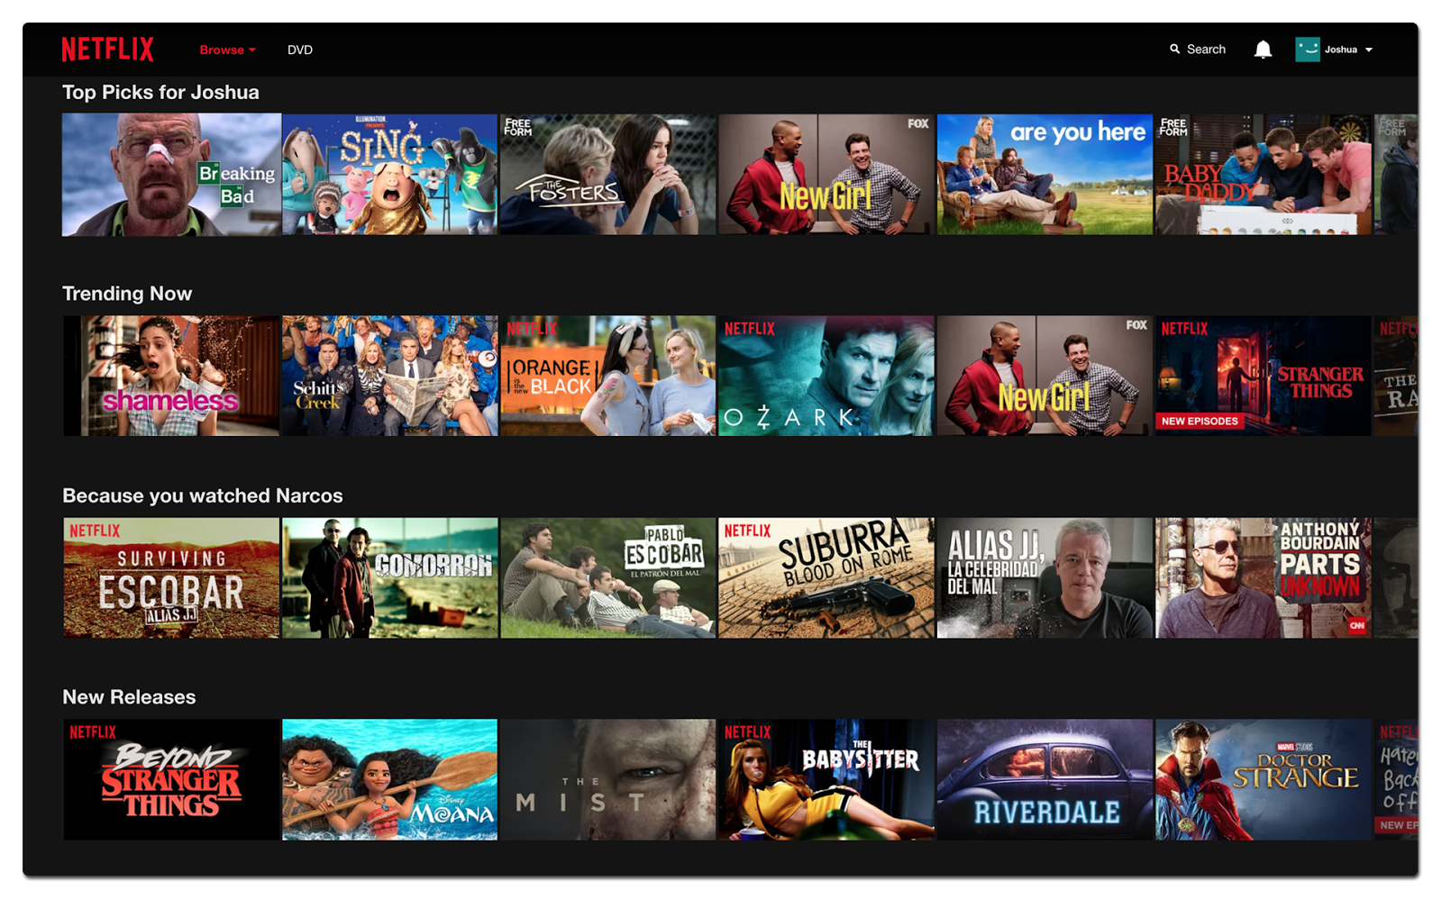
recsys
theory
state of the art
Notes:
‹#›

Slide 14
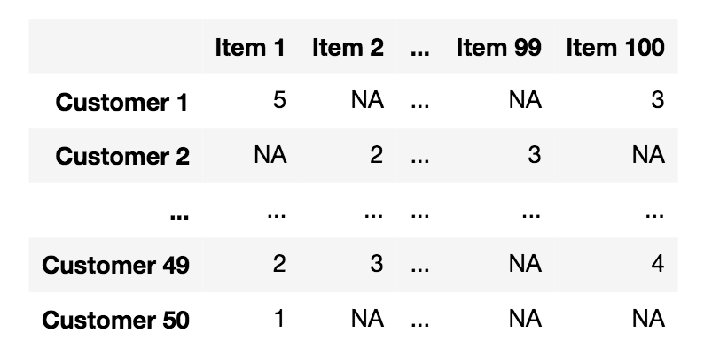
recsys
theory
at the end of the day...
Notes:
‹#›

Slide 15


recsys
theory
collaborative filtering
works by finding a set of people with preferences or tastes similar to the target user.
using this smaller set of similar people, it constructs a ranked list of suggestions
it is based on interaction between user and item
it can be a rate we call it explicit feedback
it can be a purchase of a product, a play of a film … we call it implicit feedback (we do not lie using implicit feedback)
Notes:
‹#›

Slide 16
recsys
theory
collaborative filtering
to determine whether two users are similar or not, this filter considers the movies both of them watched and/or how they rated them.
by looking at the items in common, this type of algorithm will basically predict the rate (or the probability of being watched) of a movie for a user who hasn’t watched it yet, based on the similar users’ rates
Notes:
‹#›

Slide 17

recsys
theory
collaborative filtering
sophisticated and
impersonal
“word of mouth” process
Notes:
‹#›

Slide 18
recsys
theory
collaborative filtering
how to find similar users?
we need and algorithm that minimize the distance among the interaction of each specific users and the interaction of all the users.
nearest neighbors
cosine distance (or any other distance
matrix factorization
etc.
Notes:
‹#›

Slide 19
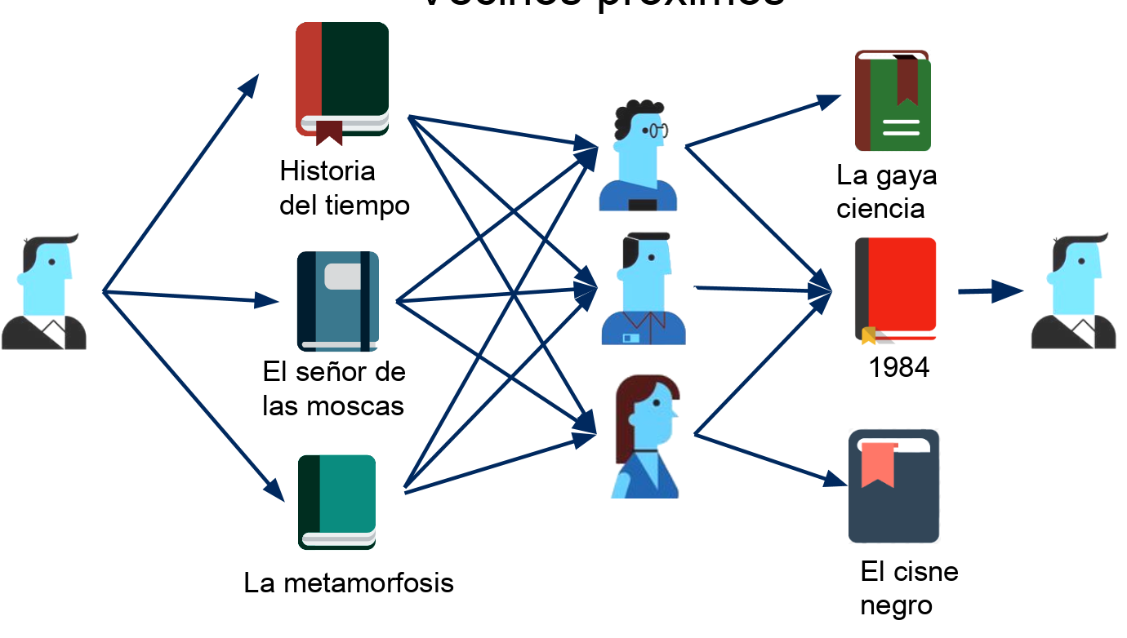
recsys
types
CL. Nearest Neighbors
Notes:
‹#›

Slide 20
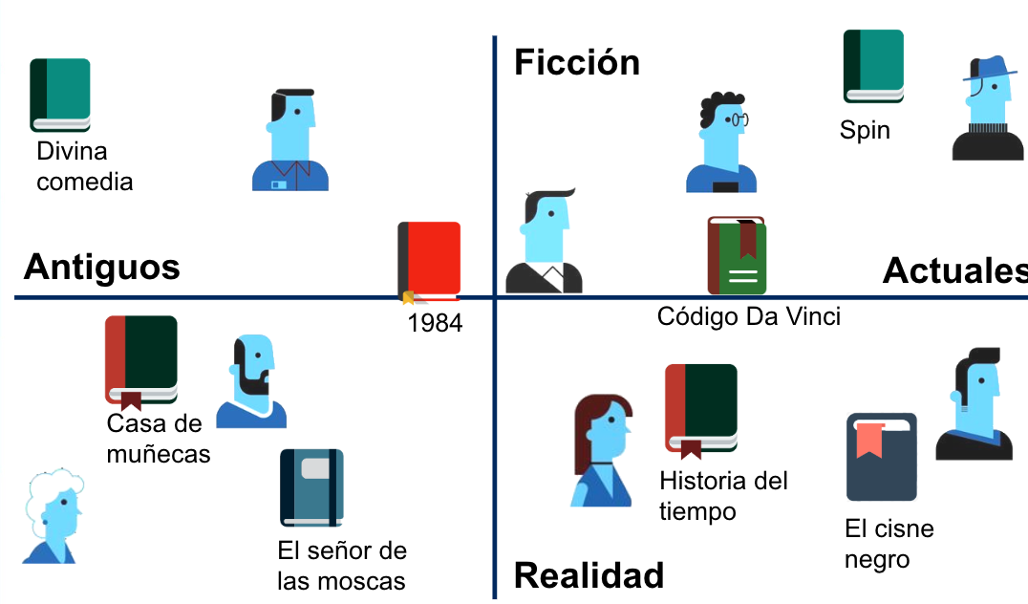
recsys
types
CL. Latent Factors
Notes:
‹#›

Slide 21
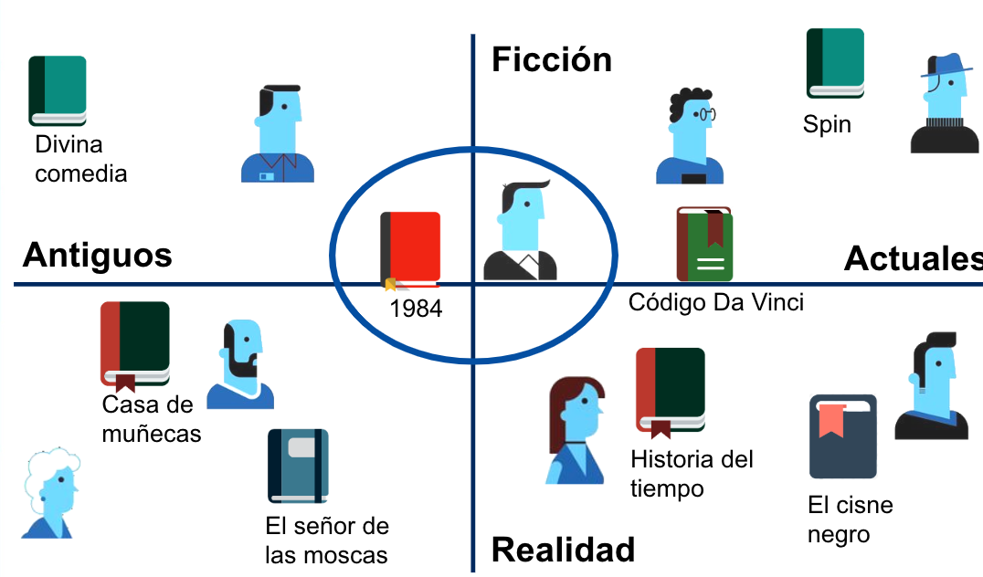
recsys
types
CL. Latent Factors
Notes:
‹#›

Slide 22
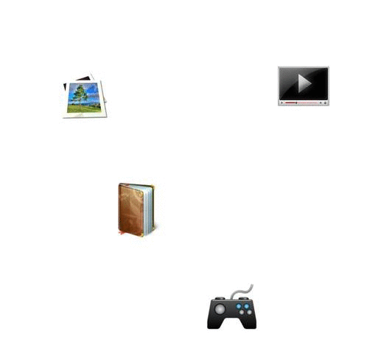
recsys
types
CL. Latent Factors
Notes:
‹#›

Slide 23
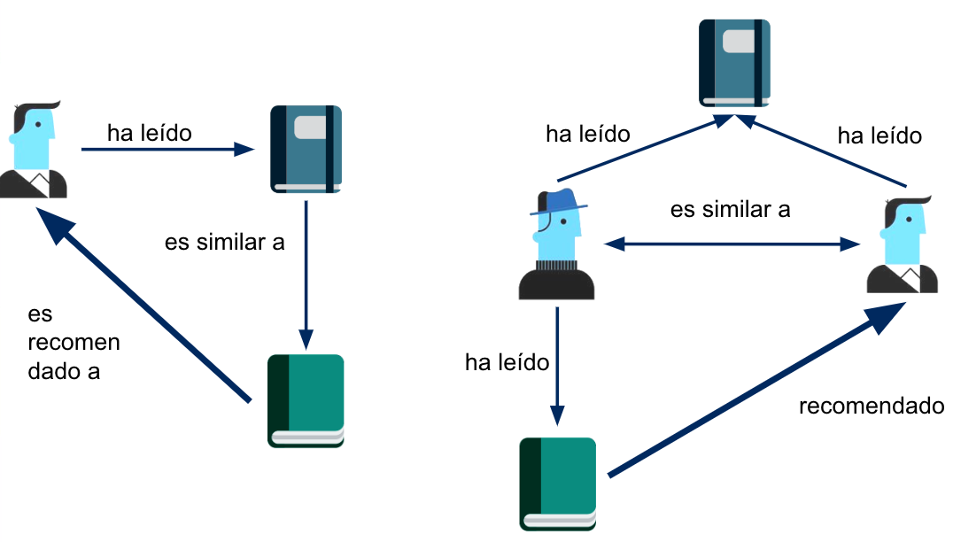
recsys
types
CB vs CF
content based VS collaborative filtering
has read
has read
has read
is similar to
is recommended to
has read
is recommended to
Notes:
‹#›

Slide 24
recsys
theory
content based
this type of recsys does not involve other users if not ourselves.
based on what we like, the algorithm will simply pick items with similar content to recommend us.
In this case there will be less diversity in the recommendations, but this will work either the user rates things or not.
cold start problem
Notes:
‹#›

Slide 25
recsys
theory
content based
solution for cold start problem (from CF)
in a recsys-CF what happen if:
we have a new user (with no historical data)
we have a new product (with no associated interaction)
content based algorithm are based on immanent information of the user or item (context or content) so you can recommend with no previous historical data because we do not user it
Notes:
‹#›

Slide 26
recsys
theory
avoid cold start problem
general purpose (text processing, inference, semantic information …)
more transparent
the methods based on Collaborative Filtering have shown to be, empirically, more precise when generating recommendations
provokes filter bubble
Notes:
‹#›

Slide 27
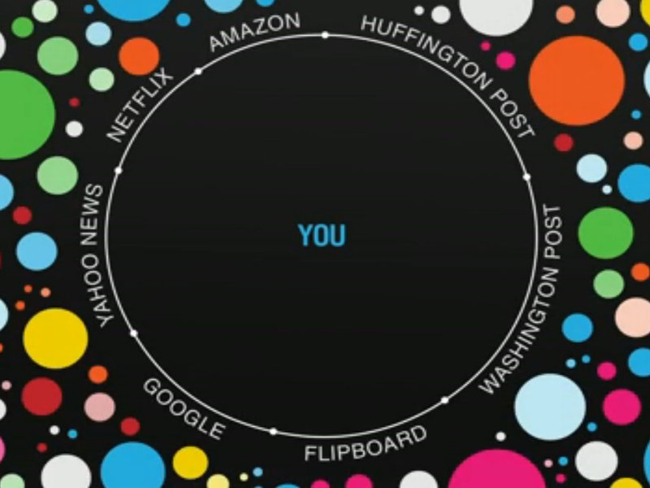
recsys
theory
Notes:
‹#›

Slide 28
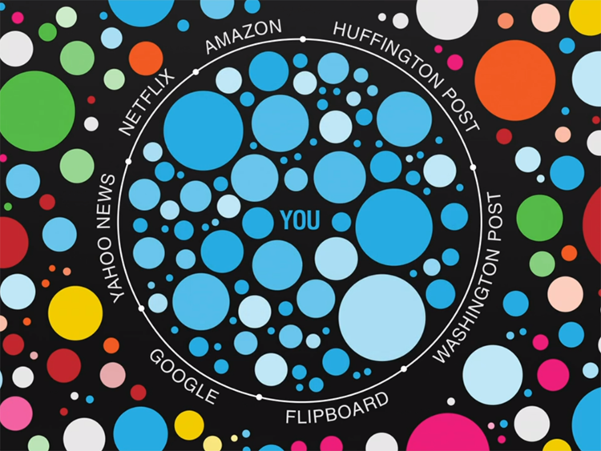
recsys
theory
Notes:
‹#›

Slide 29
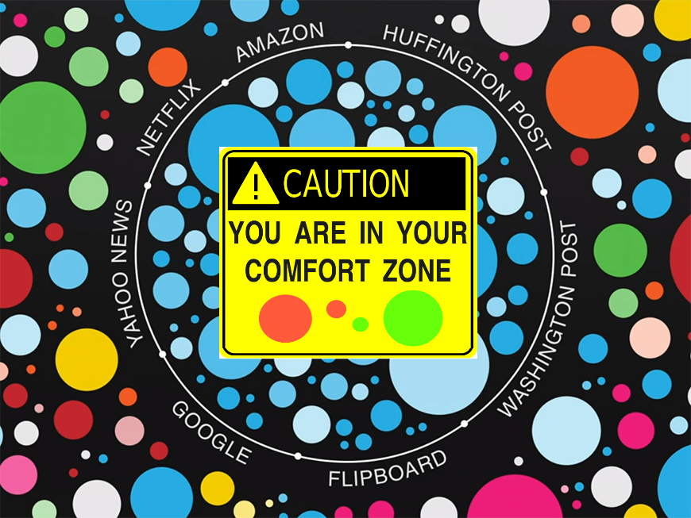
recsys
theory
Notes:
‹#›

Slide 30

recsys
theory
Notes:
‹#›

Slide 31

recsys
theory
Notes:
‹#›

Slide 32

recsys
theory
Notes:
‹#›

Slide 33
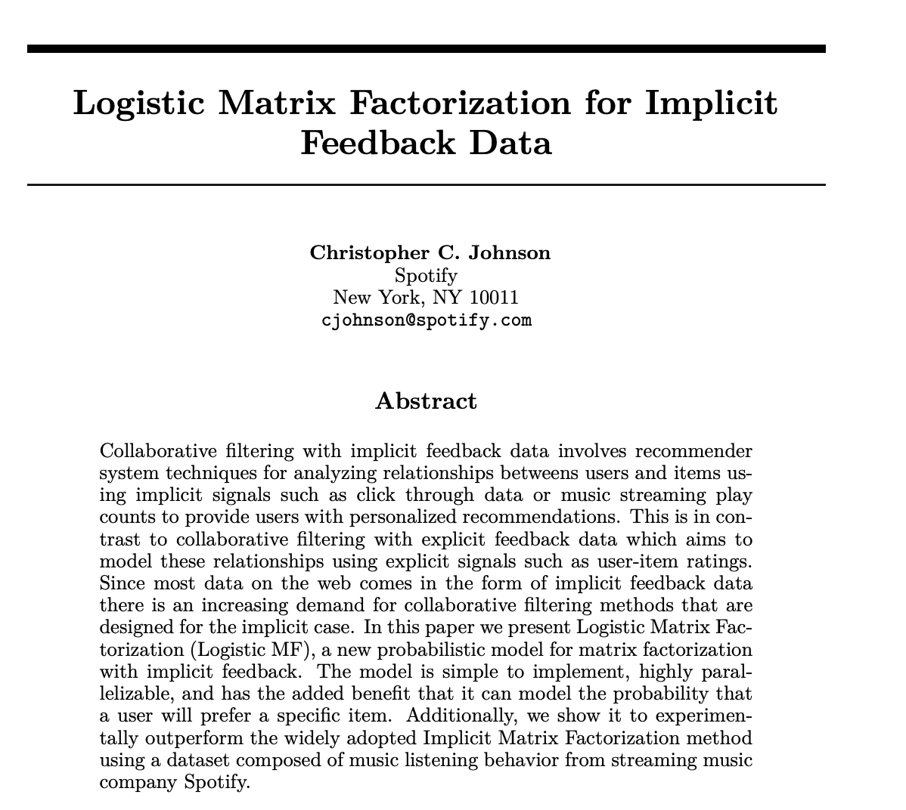
recsys
theory
Notes:
‹#›

Slide 34
recsys
theory
Matrix Factorization
MF techniques
this methods attempt to reduce dimensionality of the interaction matrix and approximate it by two or more small matrices with k latent components.
Notes:
‹#›

Slide 35
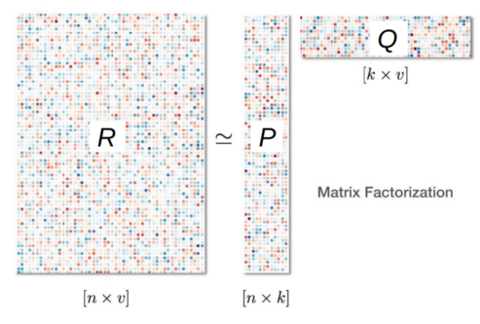
recsys
theory
Matrix Factorization
MF techniques
Notes:
‹#›

Slide 36
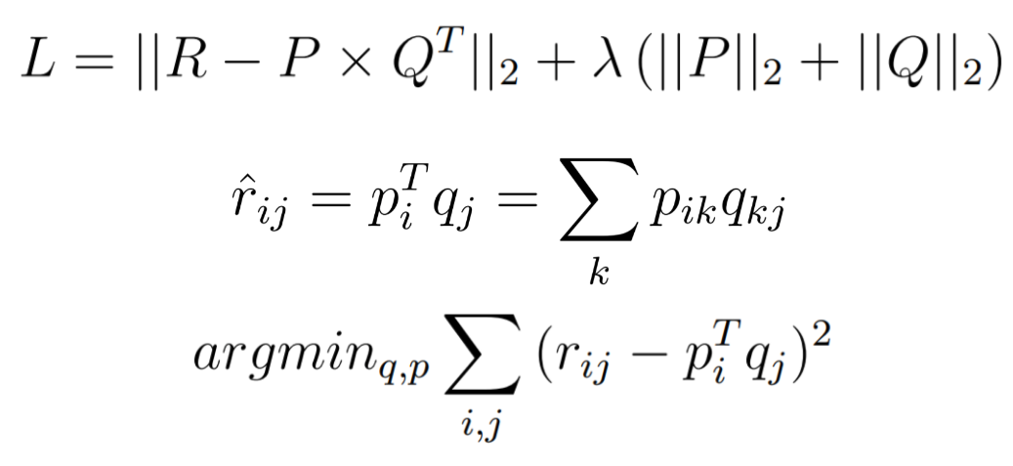
recsys
theory
Matrix Factorization
MF techniques
Notes:
‹#›

Slide 37
recsys
theory
Matrix Factorization
MF techniques
SVD. Singular Value Decomposition
SVD is a matrix factorization technique that is usually used to reduce the number of features of a data set by reducing space dimensions from N to K where K < N.
For the purpose of the recommendation systems however, we are only interested in the matrix factorization part keeping same dimensionality.
Notes:
‹#›

Slide 38
recsys
theory
Matrix Factorization
MF techniques
SVD. Singular Value Decomposition
The matrix factorization is done on the user-item ratings matrix.
From a high level, matrix factorization can be thought of as finding 2 matrices whose product is the original matrix.
Notes:
‹#›

Slide 39
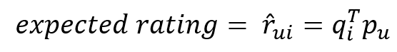
recsys
theory
Matrix Factorization
MF techniques
SVD. Singular Value Decomposition
Each item can be represented by a vector qi. Similarly each user can be represented by a vector pu such that the dot product of those 2 vectors is the expected rating
Notes:
‹#›

Slide 40
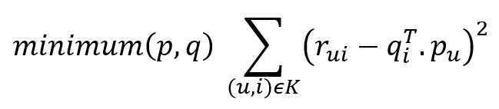
recsys
theory
Matrix Factorization
MF techniques
SVD. Singular Value Decomposition
qi and pu can be found in such a way that the square error difference between their dot product and the known rating in the user-item matrix is minimum
Notes:
‹#›

Slide 41
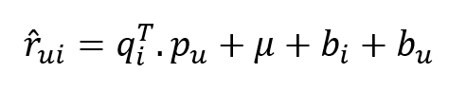
recsys
theory
Matrix Factorization
MF techniques
SVD. Singular Value Decomposition. Bias
To reduce the error between the predicted and actual value, the algorithm make use of some characteristics of the dataset.
We can add a feature for each user and for each item
Notes:
‹#›

Slide 42
recsys
theory
Matrix Factorization
MF techniques
SVD. Singular Value Decomposition
Notes:
‹#›

Slide 43
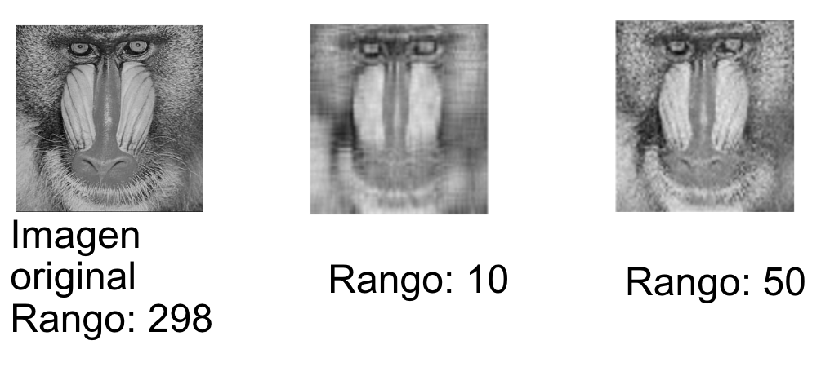
recsys
theory
Matrix Factorization
MF techniques
SVD. Singular Value Decomposition
Notes:
‹#›

Slide 44
recsys
theory
Matrix Factorization
Evaluation RecSys. It is not all about accuracy
These metrics will be for user u of U users over n items out of N potential items in a recommendation list L. Each item has a content vector C of length c
Notes:
‹#›

Slide 45
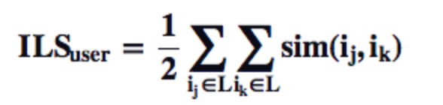
recsys
theory
Matrix Factorization
Evaluation RecSys. It is not all about accuracy
Diversity
Diversity measures how dissimilar recommended items are for a user
This similarity is often determined using the item’s content (e.g. movie genres) but can also be determined using how similarly items are rated.
Most famous Intra-List Similarity (ILS). High computation cost
Notes:
‹#›

Slide 46
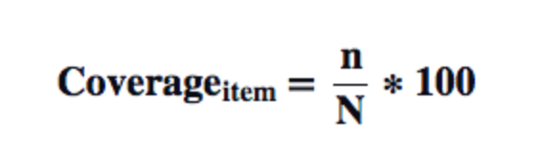
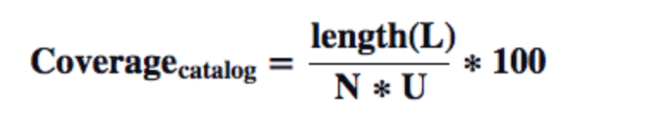

recsys
theory
Matrix Factorization
Evaluation RecSys. It is not all about accuracy
Coverage
Coverage represents the percentage of things (items, users, or ratings) that the recommender system was able to recommend.
Not being able to predict a particular set of users or items is usually caused by an insufficient number of ratings, and is generally known as the cold start problem.
Notes:
‹#›

Slide 47
recsys
theory
Matrix Factorization
Evaluation RecSys. It is not all about accuracy
Serendipity
It is the measure of how surprising the successful or relevant recommendations are
he serendipity method we’ve implemented comes from a Recommender System Coursera course taught by Prof Joseph Konstan of University of Minnesota and Prof Michael Ekstrand of Texas State University.
Notes:
‹#›

Slide 48
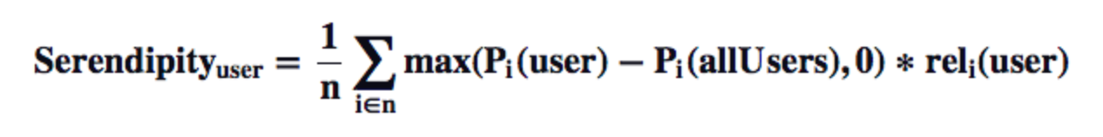
recsys
theory
Matrix Factorization
Evaluation RecSys. It is not all about accuracy
Serendipity
There are two parts to this equation: degree of surprise and relevance to the user.
Surprise is measured as the difference of the probability an item i is recommended for a user and the probability that item i is recommended for any user.
The probability of a recommendation is simply a function of its overall rank over n items:
Notes:
‹#›

Slide 49
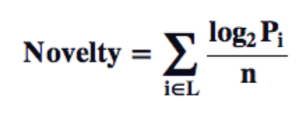
recsys
theory
Matrix Factorization
Evaluation RecSys. It is not all about accuracy
Novelty
Novelty determines how unknown recommended items are to a user.
Higher novelty values represents that less popular items are being recommended, thus less well-known items are likely being surfaced for users.
Notes:
‹#›

Slide 50

recsys
theory
Matrix Factorization
Evaluation RecSys. It is not all about accuracy
Relevancy
Sometimes they want you to watch an specific relevant content (like those in picture below) so the weight of those content in a specific evaluation metric will be higher.
Notes:
‹#›

Slide 51
recsys
theory
Matrix Factorization
Evaluation RecSys. It is not all about accuracy
Summary
Diversity –How dissimilar are the recommendations?
Coverage — What percentage of the user-item space can be recommended?
Serendipity — How surprising are the relevant recommendations?
Novelty — How surprising are the recommendations in general?
Relevancy — How relevant are the recommendations?
Notes:
‹#›

Slide 52

recsys
practice
Notes:
‹#›

Slide 53


